Slide 1
Design Patterns
Banu Prakash
banuprakash.cr@gmail.com

Slide 2
Design Patterns
Design patterns popularized by Gang Of Four 1994
Erich Gamma
Richard Helm
Ralph Johnson
John Vlissides
Design patterns are like special recipes that help us solve common problems in programming.
Imagine you're building a LEGO castle, and you have different sets of instructions for making walls, towers, and doors.
Each instruction set is a design pattern that shows you how to build something specific without having to start from scratch every time.

Slide 3
Design Patterns
Understanding Problems
Just like how you might face a tricky situation while building your LEGO castle (like how to connect two parts), programmers often encounter similar challenges while writing code.
Finding Solutions
For each common problem, there's a design pattern that provides a solution. These patterns are tried and tested, so they help make the job easier and faster.
Using Design Patterns
When you use a design pattern, it's like following a simple set of LEGO instructions. You look at the pattern and see how to apply it in your code.

Slide 4
SOLID Design principles
Coined by Uncle BOB [Robert C Martin]
S -> Single Responsibility Principle
O -> Open Close Principle
L -> Liskov Substitution Principle
D -> Dependency Injection

Slide 5

Single Responsibility
Swiss army knife or all the tools
When traveling, portability is the most important thing. The Swiss army knife is the appropriate tool.
But for day-to-day life — would you cut bread, mend the car, or open cans with a Swiss army knife? Probably not. You can do it, but it’s much easier to use a bread knife, a set of screwdrivers, or a can-opener.
Real-life code should be treated the same. A do-it-all class (god object) it’s ok, it will get the job done when you are on the go (like prototyping or scripting) but not for everyday use.

Slide 6
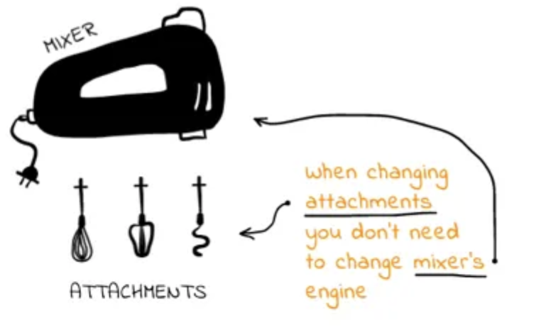
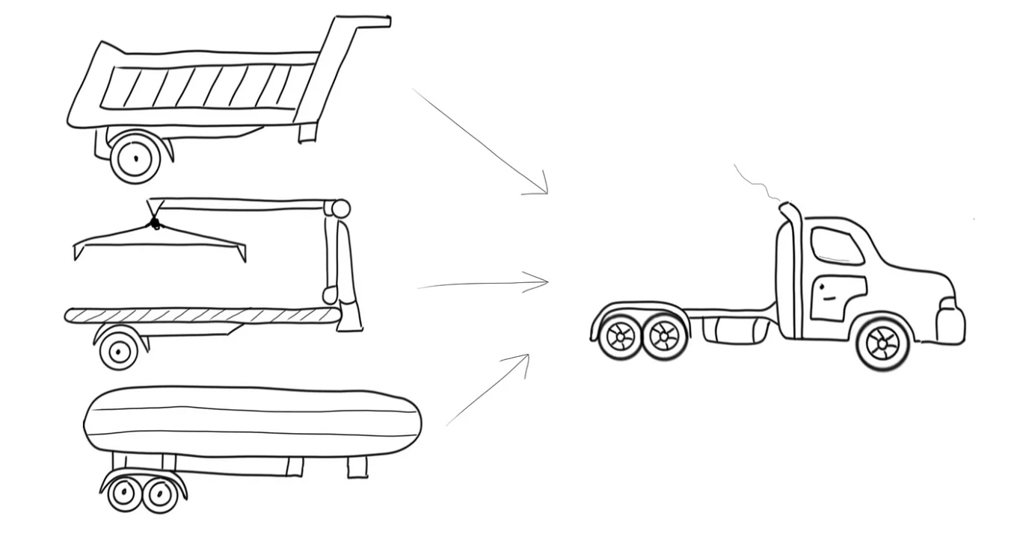
Open CLOSE Principle
Software entities should be open for extension, but close for modification
Allow behavior to be extended without modifying the source code
Trucks are one versatile piece of equipment. They can do different tasks based on the type of trailer attached to them.

Slide 7
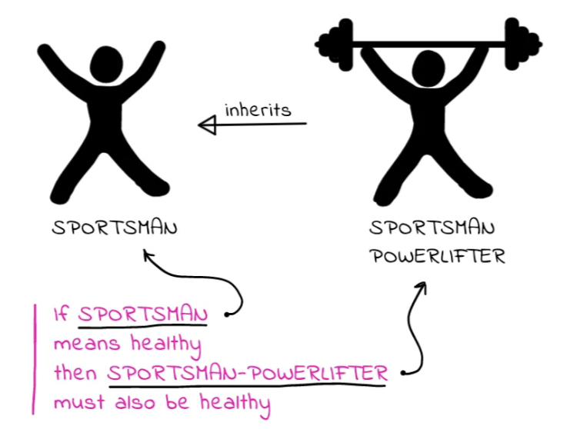
Liskov Substitution Principle
Objects in a program should be replaceable with instances of their subtypes without altering the correctness of that program

Slide 8

Interface segregation principle
Many client specific interfaces are better than on general purpose interface.
Client code shouldn’t be forced to implement methods that it doesn’t use.

Slide 9
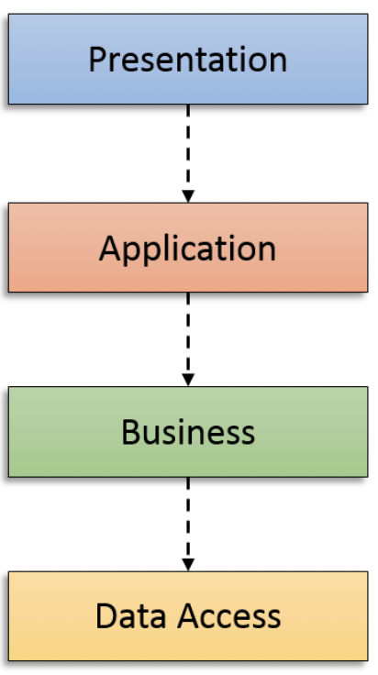
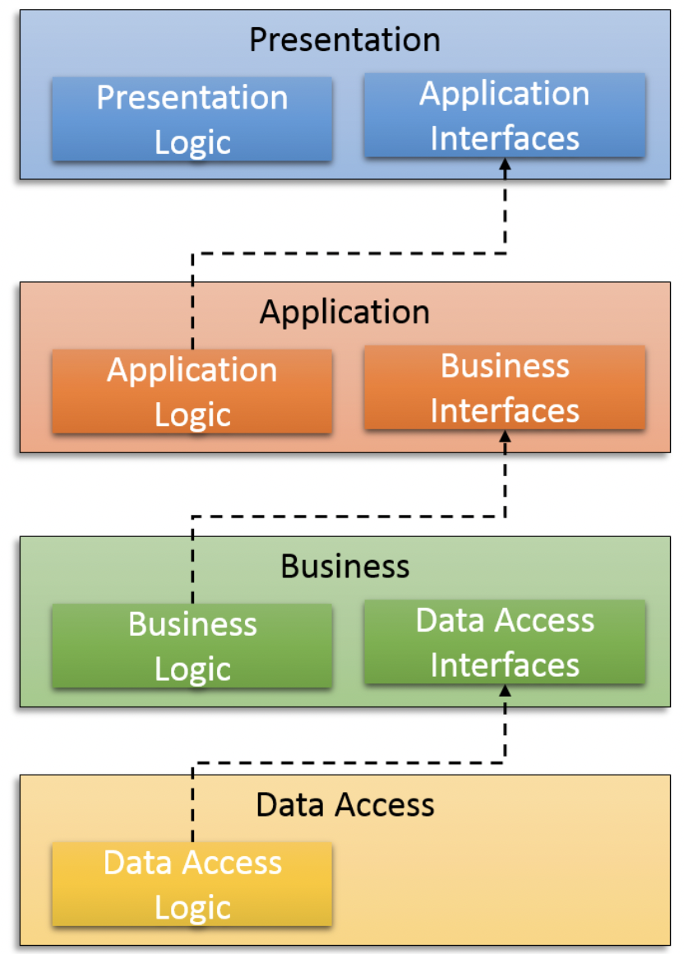
DEPENDENCY INVERSION PRINCIPLE
High-level modules should not depend on low-level modules. Both should depend on abstractions.
Abstractions should not depend on details. Details should depend on abstractions.

Slide 10
Design Patterns
What does the pattern consist of?
Intent of the pattern briefly describes both the problem and the solution.
Motivation further explains the problem and the solution the pattern makes possible.
Structure of classes shows each part of the pattern and how they are related.
Design patterns are a toolkit of tried and tested solutions to common problems in software design.
Even if you never encounter these problems, knowing patterns is still useful because it teaches you how to solve all sorts of problems using principles of object-oriented design.
Design patterns define a common language that you and your teammates can use to communicate more efficiently.
You can say, “Oh, just use a Singleton for that,” and everyone will understand the idea behind your suggestion. No need to explain what a singleton is if you know the pattern and its name.

Slide 11
Classifications of patterns
Creational patterns provide object creation mechanisms that increase flexibility and reuse of existing code.
Structural patterns explain how to assemble objects and classes into larger structures, while keeping these structures flexible and efficient.
Behavioral patterns take care of effective communication and the assignment of responsibilities between objects.

Slide 12
CREATIONAL PATTERNS
Builder
Lets you construct complex objects step by step.
The pattern allows you to produce different types and representations of an object using the same construction code.
Factory
Component responsible solely for the wholesale (not piecewise) creation of objects
Prototype
Lets you copy existing objects without making your code dependent on their classes
Singleton
A Component which is instantiated only once.

Slide 13
Builder
Intent
Builder is a creational design pattern that lets you construct complex objects step by step. The pattern allows you to produce different types and representations of an object using the same construction code.
Motivation
Some objects are simple and can be created in a single initializer call
Other objects require lot of ceremony to create
Having 10-12 arguments is not productive
Builder provides an API for constructing an object step-by-step

Slide 14
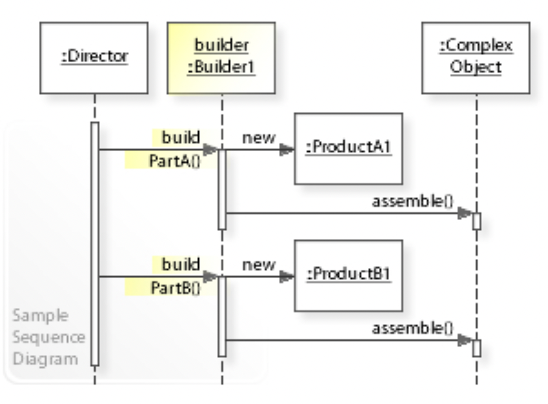
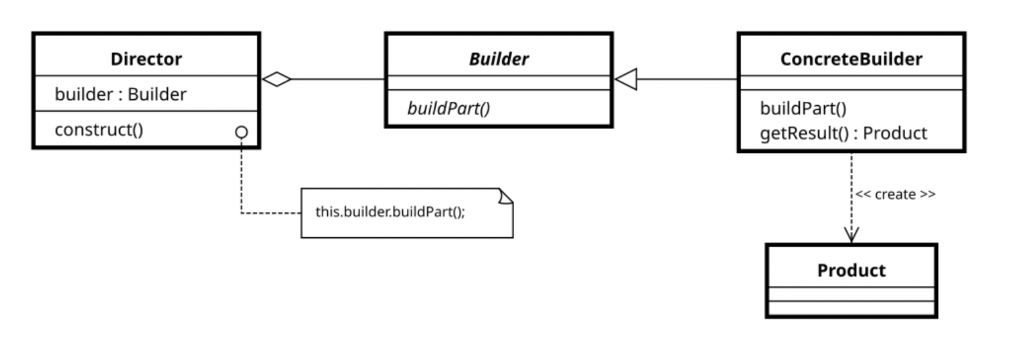
Builder
Structure and Sequence diagram

Slide 15
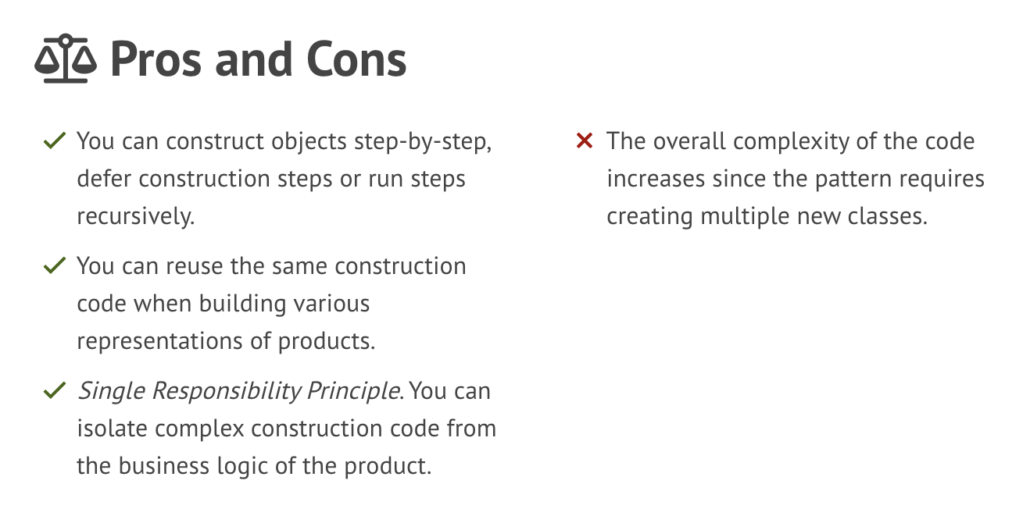
Builder

Slide 16
FACTORY
Factory
A component responsible solely for the wholesale (not piecewise) creation of objects.
Motivation:
Object creation logic becomes too convoluted [complex / complicated / elaborate]
Wholesale object creation (non-piecewise like builder) can be outsourced to
A Separate method ( factory method)
That might exist in a separate class (Factory)
Can create hierarchy of factories with Abstract factory

Slide 17
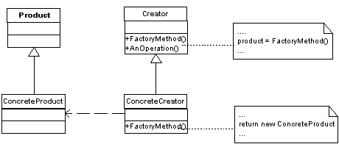
FACTORY METHOD
Structure

Slide 18
ABSTRACT FACTORY
Intent
The abstract factory pattern provides a way to encapsulate a group of individual factories that have a common theme without specifying their concrete classes
Abstract Factory is a creational design pattern that lets you produce families of related objects without specifying their concrete classes.
Imagine that you’re creating a furniture shop simulator. Your code consists of classes that represent:
A family of related products, say: Chair + Sofa + CoffeeTable.
Several variants of this family. For example, products Chair + Sofa + CoffeeTable are available in these variants: Modern, Victorian, ArtDeco.

Slide 19
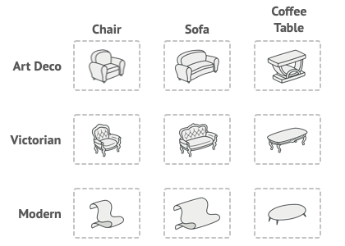
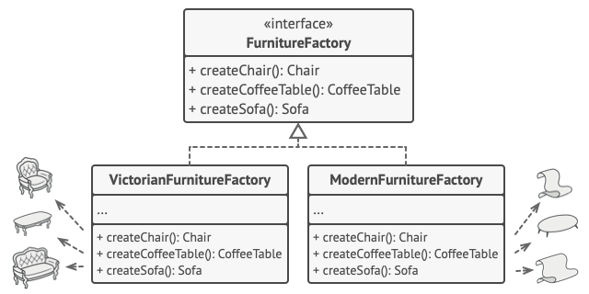
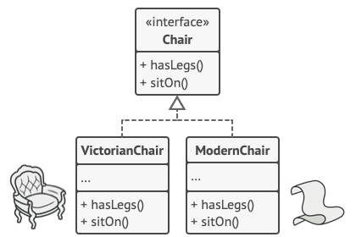
ABSTRACT FACTORY

Slide 20
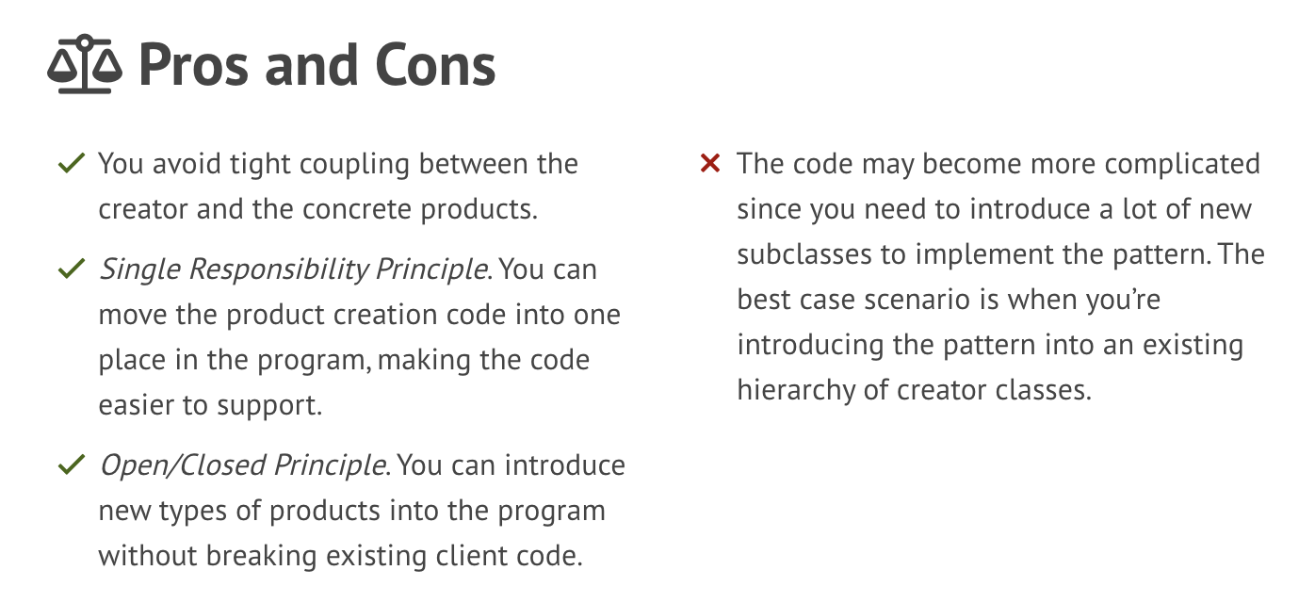
Abstract factory

Slide 21
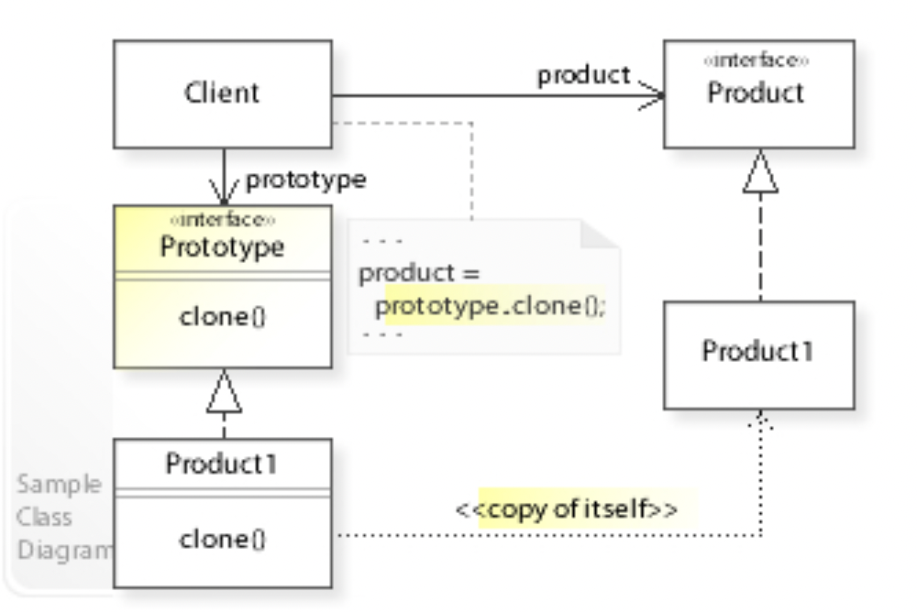
prototype
INTENT
When it’s easier to copy an existing object to fully initialize a new one
Motivation:
Complicated objects aren’t designed from scratch. They reiterate existing design
An existing (partially or fully constructed) design is a prototype
We make a copy/clone the prototype and customize it

Slide 22
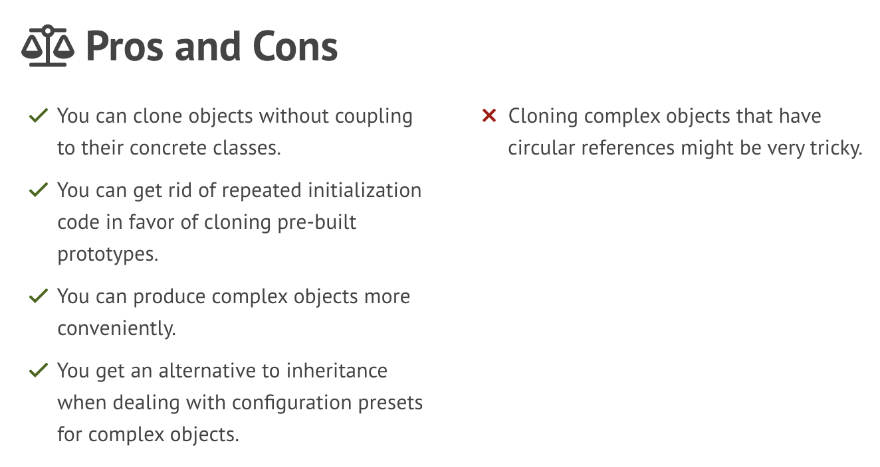
prototype

Slide 23
singleton
Intent
Singleton is a creational design pattern that lets you ensure that a class has only one instance, while providing a global access point to this instance.
Motivation:
Centralized management: Singletons are often used to manage internal or external resources in a centralized way.
Global access: Singletons provide a global point of access to themselves.
Initialization: Initialization is simpler because you only have to do it once for the single instance.
Queuing: A singleton can implement internal queuing to make sure that one sound file stops or finishes before it tries to play another.

Slide 24
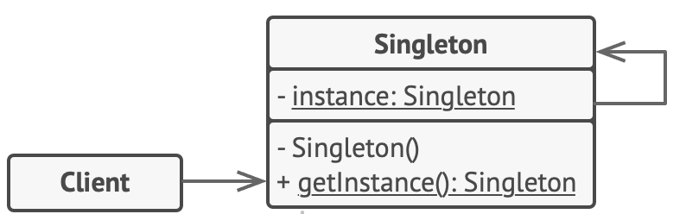
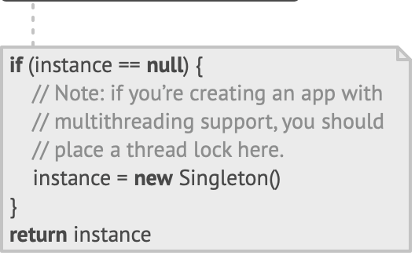
singleton
Structure

Slide 25
STRUCTURAL PATTERN
Structural patterns explain how to assemble objects and classes into larger structures, while keeping these structures flexible and efficient.

Slide 26
Decorator pattern
Decorator is a structural design pattern that lets you attach new behaviours to objects by placing these objects inside special wrapper objects that contain the behaviours.
Motivation
Want to augment an object with additional functionalities
Do not want to rewrite or alter existing code (OCP)
Want to keep new functionalities separate (SRP)
Need to be able to interact with existing structure
Two Options
Inherit from required object
Build a decorator, which simply references the decorated object(s)

Slide 27
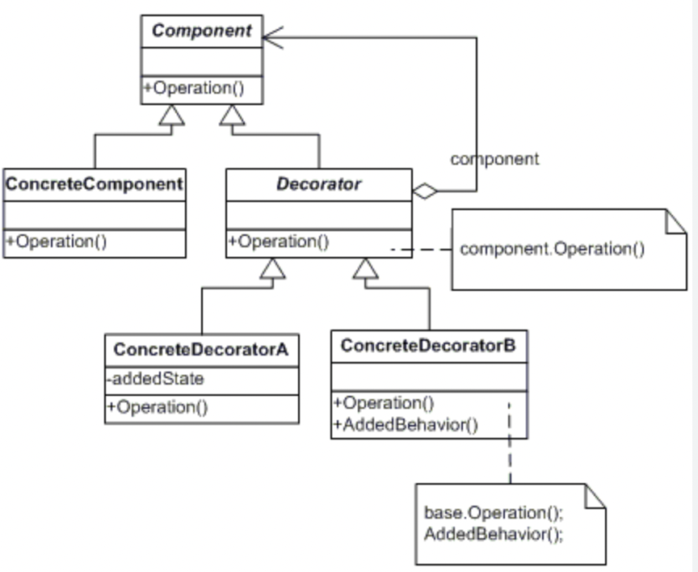
Decorator pattern
Structure

Slide 28
Façade pattern
Facade is a structural design pattern that provides a simplified interface to a library, a framework, or any other complex set of classes.
Problem:
Imagine that you must make your code work with a broad set of objects that belong to a sophisticated library or framework. Ordinarily, you’d need to initialize all of those objects, keep track of dependencies, execute methods in the correct order, and so on.

Slide 29
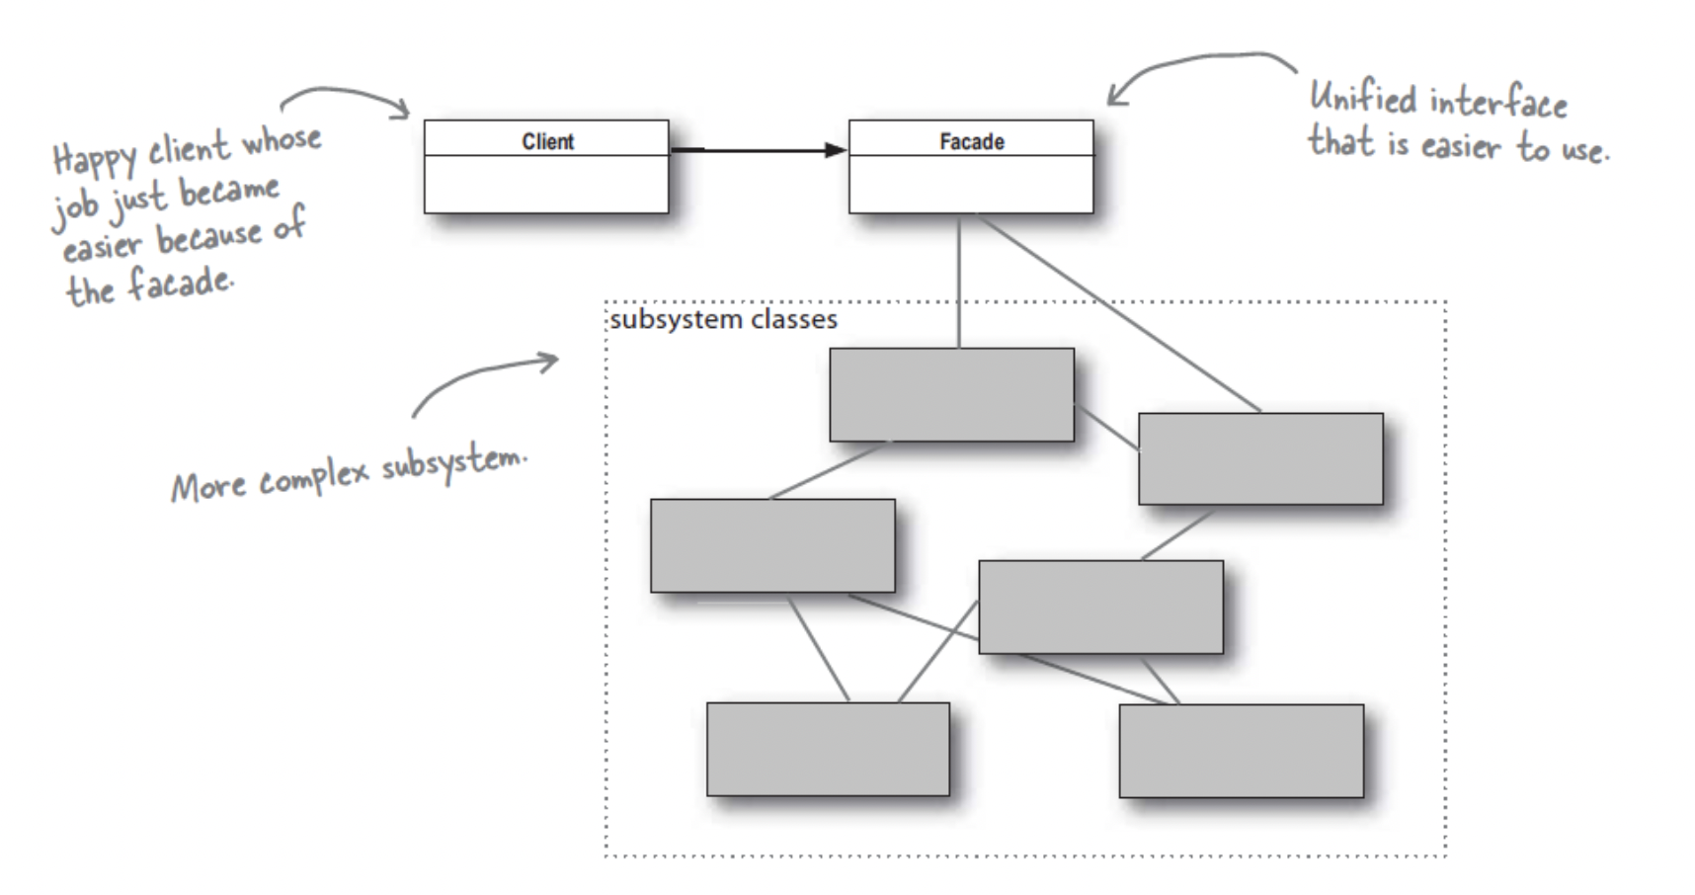
Façade pattern

Slide 30
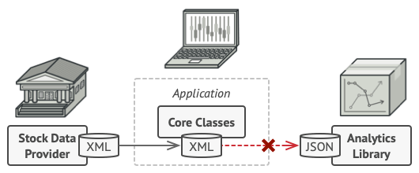
Adapter pattern
Adapter is a structural design pattern that allows objects with incompatible interfaces to collaborate.
Problem
Imagine that you’re creating a stock market monitoring app. The app downloads the stock data from multiple sources in XML format and then displays nice-looking charts and diagrams for the user.
At some point, you decide to improve the app by integrating a smart 3rd-party analytics library. But there’s a catch: the analytics library only works with data in JSON format.
You could change the library to work with XML. However, this might break some existing code that relies on the library. And worse, you might not have access to the library’s source code in the first place, making this approach impossible.

Slide 31
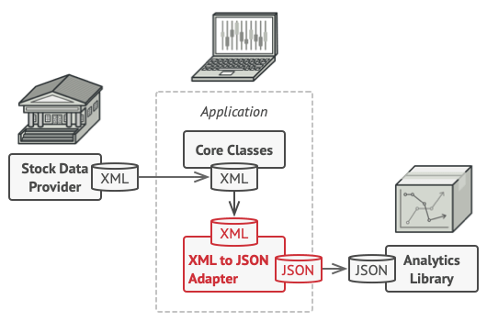
Adapter pattern
Solution
You can create an adapter. This is a special object that converts the interface of one object so that another object can understand it.
Determine the API we have and the API you need.
Create a component which aggregates the adaptee

Slide 32
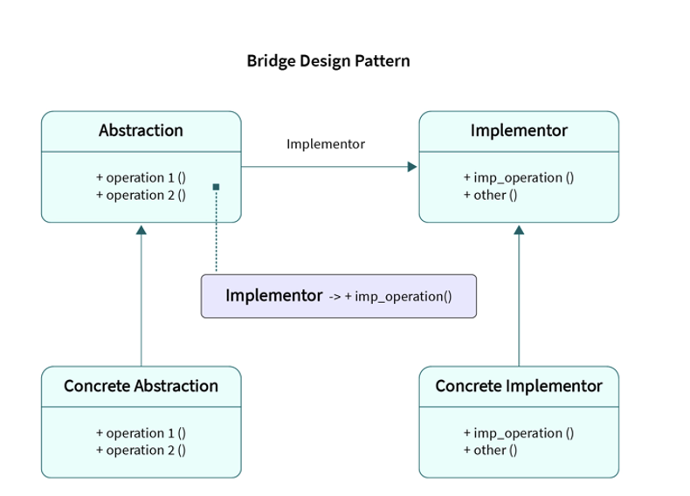
Bridge pattern
Bridge is a structural design pattern that lets you split a large class or a set of closely related classes into two separate hierarchies—abstraction and implementation—which can be developed independently of each other.
It’s a hierarchy breaker.

Slide 33
composite pattern
Motivation:
Objects use other objects’ fields/methods through inheritance and composition.
Composition lets us make compound objects
Composite design pattern is used to treat both single(scalar) and composite objects uniformly
Using the Composite pattern makes sense only when the core model of your app can be represented as a tree.
For example, imagine that you have two types of objects: Products and Boxes. A Box can contain several Products as well as a number of smaller Boxes. These little Boxes can also hold some Products or even smaller Boxes, and so on.

Slide 34
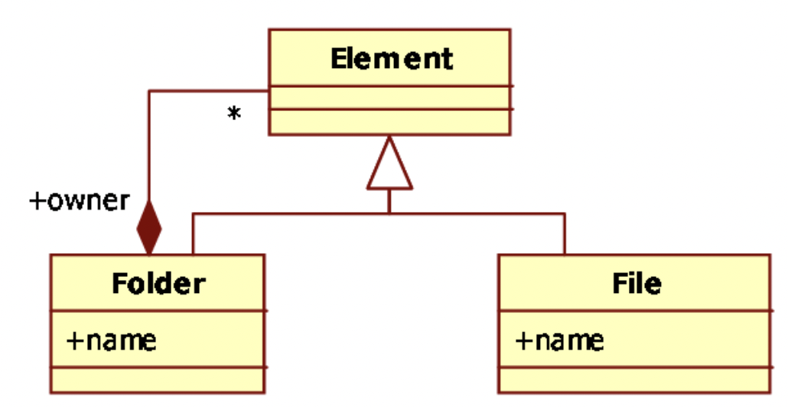
Composite pattern

Slide 35
Flyweight pattern
Motivation
Conserves memory by sharing “expensive” objects. “expensive” objects – objects which require much space
Flyweight objects are immutable – changes effect other objects
Benefit:
Reduce # of objects
Decrease memory consumption
Increase Performance

Slide 36
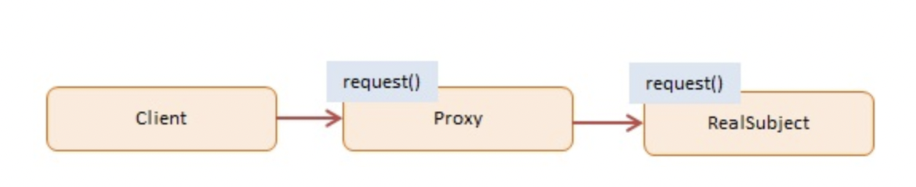
Proxy pattern
Proxy is a structural design pattern that lets you provide a substitute or placeholder for another object. A proxy controls access to the original object, allowing you to perform something either before or after the request gets through to the original object.

Slide 37
Behavioral design pattern
Behavioral design patterns are concerned with algorithms and the assignment of responsibilities between objects.

Slide 38
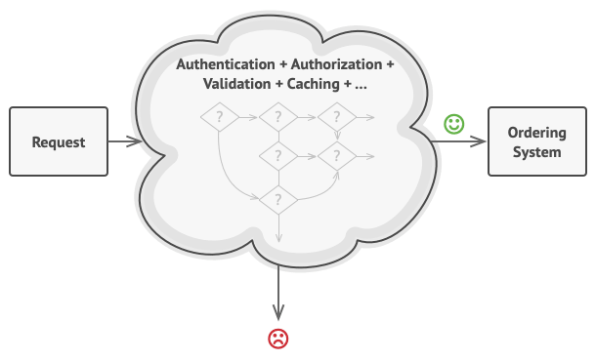
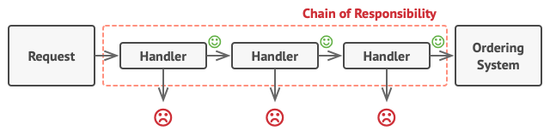
Chain of responsibility
Chain of Responsibility is a behavioral design pattern that lets you pass requests along a chain of handlers. Upon receiving a request, each handler decides either to process the request or to pass it to the next handler in the chain.
Problem: The bigger the code grew, the messier it became. | Solution: Chain of Responsibility relies on transforming particular behaviors into stand-alone objects called handlers.

Slide 39
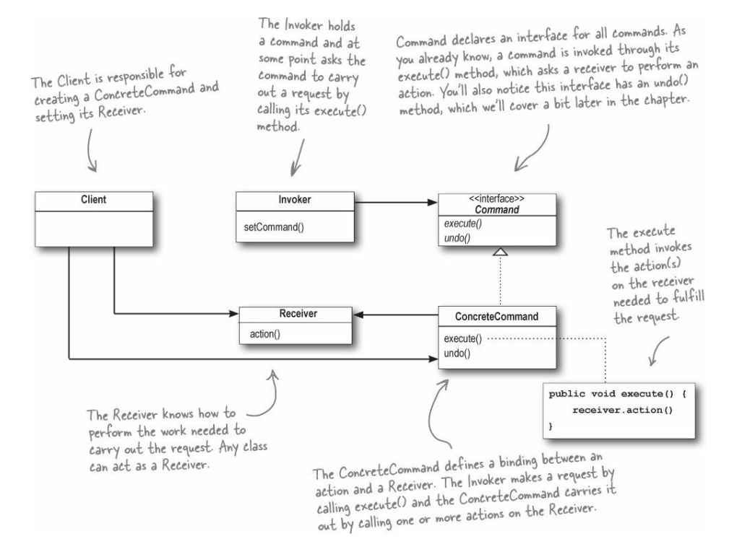
Command pattern
Command is a behavioral design pattern that turns a request into a stand-alone object that contains all information about the request. This transformation lets you pass requests as a method arguments, delay or queue a request’s execution, and support undoable operations

